Slide 1
Ultrasonic Sensor proximity sensor
Budi Rahardjo
2023

Slide 2
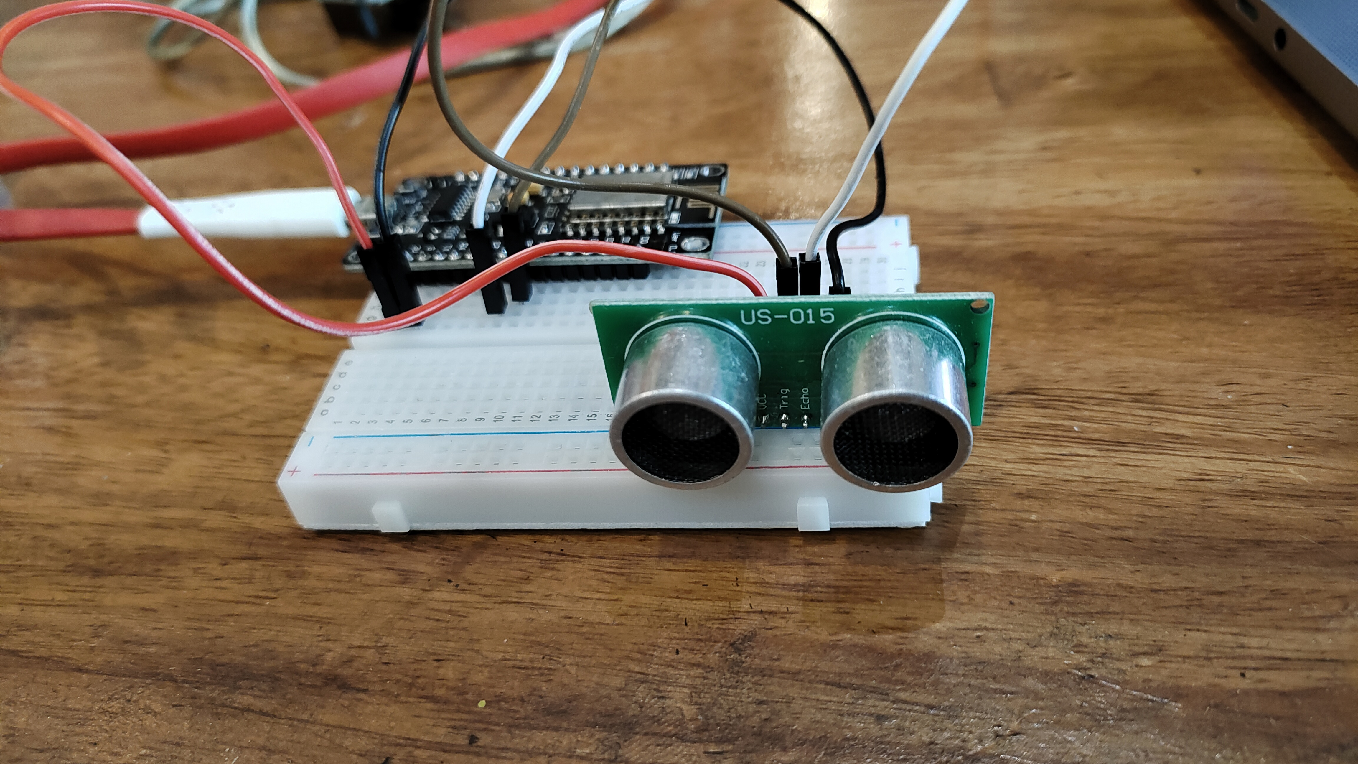

Slide 3
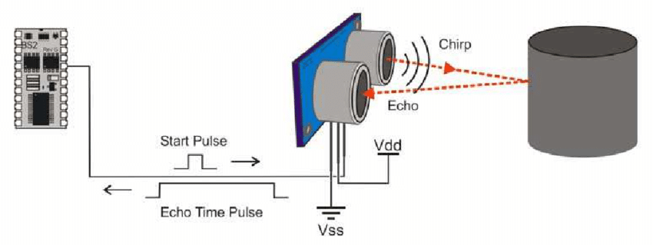

Slide 4
How it works
Sends ultrasonic sound (above 20 kHz) and measure the time it takes to propagate back to the receiver
Distance = time x speed of sound / 2

Slide 5
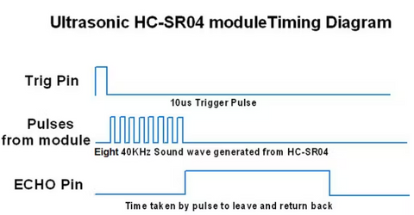

Slide 6
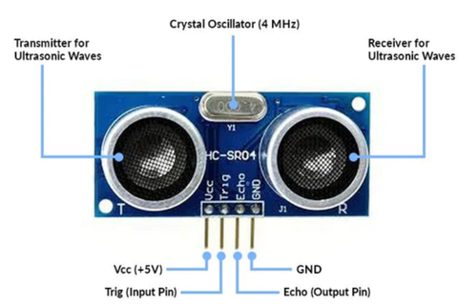

Slide 7
const int trigPin = D5;
const int echoPin = D6;
long duration; int distance;
void setup() {
pinMode(trigPin, OUTPUT);
pinMode(echoPin, INPUT);
Serial.begin(9600); //
}
void loop() {
digitalWrite(trigPin, LOW); delayMicroseconds(2);
digitalWrite(trigPin, HIGH); delayMicroseconds(10);
digitalWrite(trigPin, LOW);
duration = pulseIn(echoPin, HIGH);
distance= duration*0.034/2;
Serial.print("Distance: "); Serial.println(distance);
delay(100);
}

Slide 8
Data
HC-SR04
Max 400 cm
Tolerance 3mm

Slide 9
References
https://robocraze.com/blogs/post/what-is-ultrasonic-sensor

